Slide 1
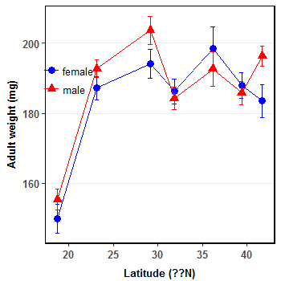

Slide 2
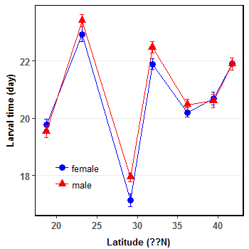
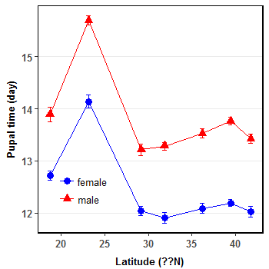
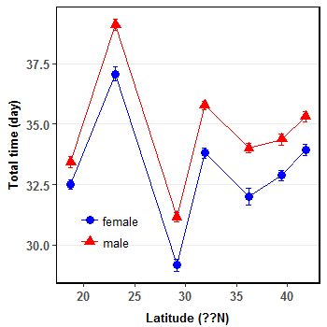

Slide 8
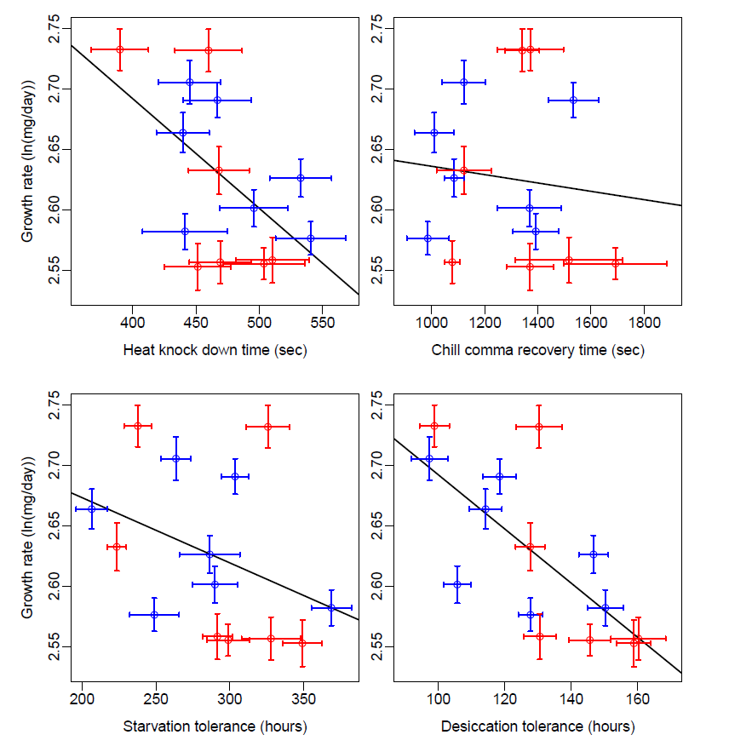
Model: growth_rate~desiccation
Adjusted R^2=0.4399, p=0.0058
Model: growth_rate~hkt
Adjusted R^2=0.2402, p=0.0432

Slide 9
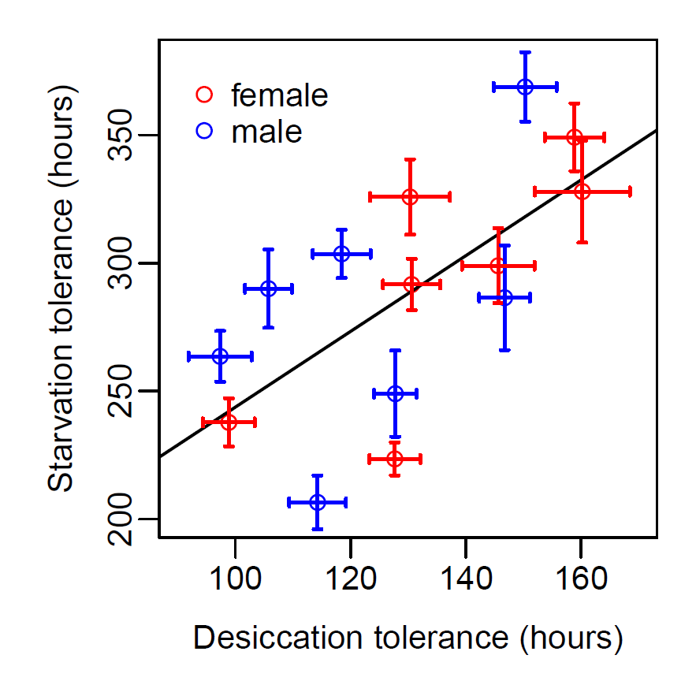
Model: lm(starvation~desiccation)
Adjusted R^2=0.38, p=0.01118

